Slide 1
CPU Cache Coherence & Memory Consistency
何登成

Slide 2
个人简介
何登成
网易-杭州研究院-后台技术中心
负责产品
DDB： 分布式数据库；
TNT/NTSE： 自主研发的存储引擎；
联系方式
邮箱/Popo： hzhedengcheng@corp.netease.com
新浪微博： 何_登成 (http://weibo.com/u/2216172320)

Slide 3
内容简介
关注CPU的两个核心功能
Cache Coherence
Memory Consistency
Definition
Many modern computer systems and most multicore chips support shared memory in hardware. In a shared memory system, each of the processor cores may read and write to a single shared address space. For a shared memory machine, the memory consistency model defines the architecturally visible behavior of its memory system. Consistency definitions provide rules about loads and stores (or memory reads and writes) and how they act upon memory. As part of supporting a memory consistency model, many machines also provide cache coherence protocols that ensure that multiple cached copies of data are kept up-to-date.
A primer on Memory Consistency and Cache Coherence (Synthesis Lectures on Computer Architecture)

Slide 4
Outline
CPU Cache
Cache Structure
Cache Coherence
Memory Consistency
Atomic vs Reorder
Memory Barrier
Compiler Memory Barrier
CPU Memory Barrier
Load Acquire vs Store Release
并发程序设计
Implement a spin lock
一个真实案例
Others

Slide 5
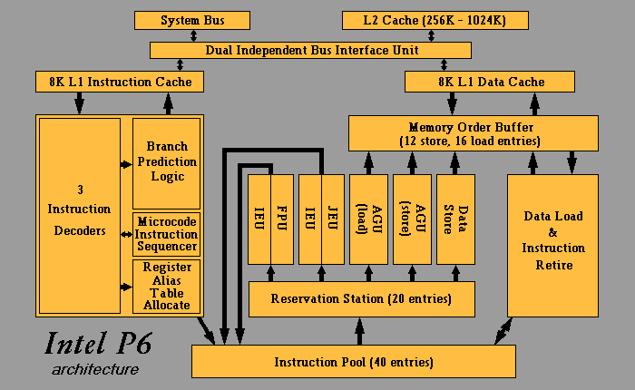
CPU Architecture(复杂版)

Slide 6
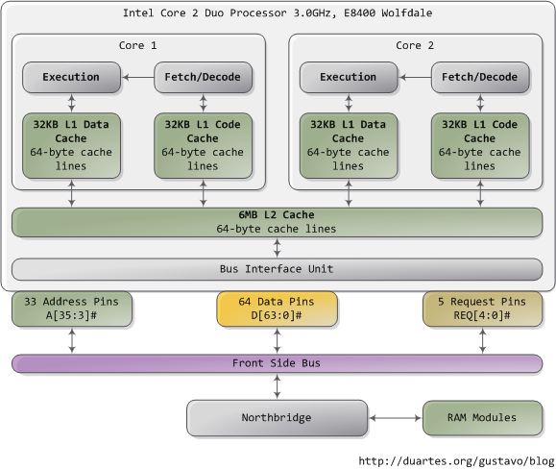
CPU Architecture(简化版)
Notes:
Getting Physical With Memory. http://duartes.org/gustavo/blog/post/getting-physical-with-memory

Slide 7
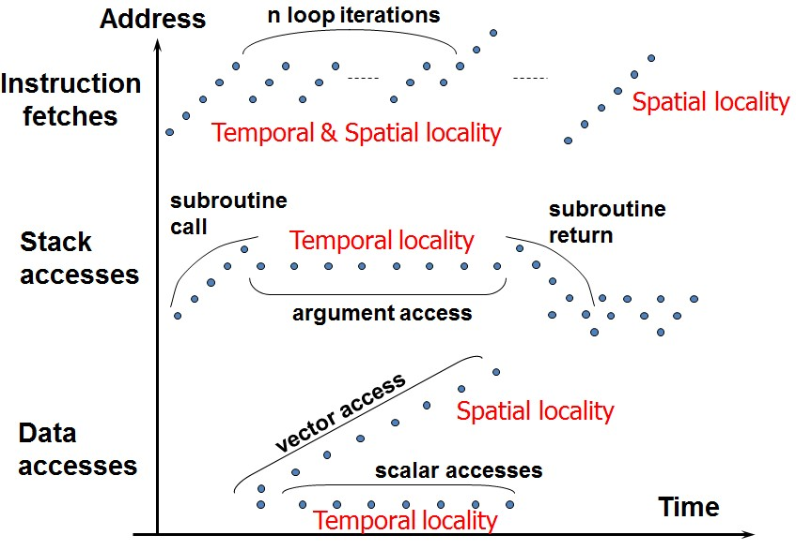
CPU Cache
What is a cache?
Small, fast storage used to improve average access time to slow memory.
Cache原理 (Memory Access Pattern)
Spatial Locality
Temporal Locality
Notes:
Cache. http://vdisk.weibo.com/s/ItKHC

Slide 8
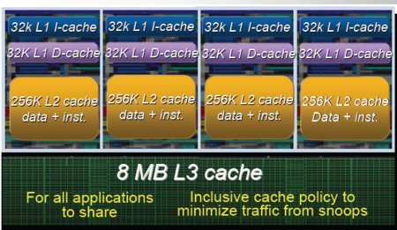
Cache Hierarchy
Multi-Level of Cache
Nehalem (Three-Level)
L1(Per-Core)：32 KB D-Cache；32 KB I-Cache；
L2(Per-Core)：256 KB；
L3(Shared)： 8M；
How to Test Cache Size？
Igor’s Blog (Example 3)
Pentium(R) Dual-Core CPU E5800(Two-Level)
本人PC机
32 KB L1 Data Cache；32 KB L1 Instruction Cache；
2 MB L2 Cache；(Unified Cache)
Notes:
Nehalem - Everything You Need to Know about Intel's New Architecture. http://impact.asu.edu/cse591sp11/Nehalem.pdf
Intel Core i7 (Nehalem): Architecture By AMD? http://www.tomshardware.com/reviews/Intel-i7-nehalem-cpu,2041-10.html
Understanding the CPU Cache. https://wiki.csiro.au/display/ASC/Understanding+the+CPU+Cache
Gallery of Processor Cache Effects. http://igoro.com/archive/gallery-of-processor-cache-effects/

Slide 9
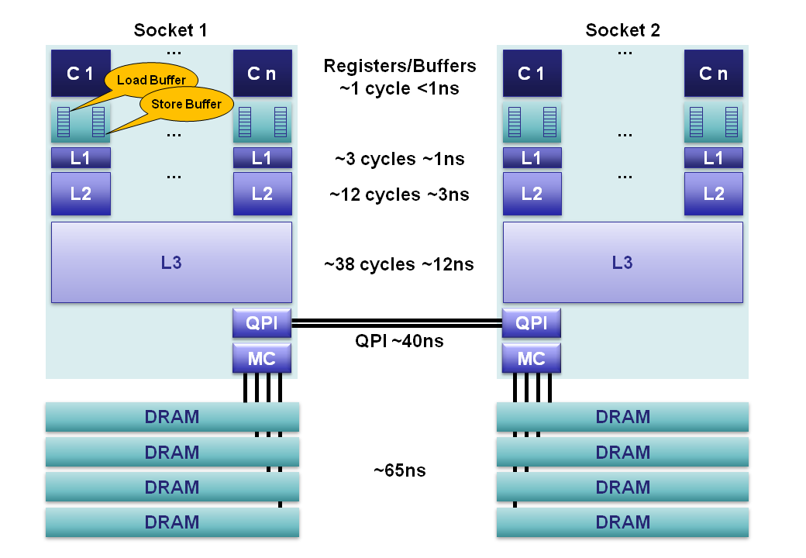
Cache Performance
Notes:
CPU Cache Flushing Fallacy. http://mechanical-sympathy.blogspot.com/2013/02/cpu-cache-flushing-fallacy.html
http://users.atw.hu/instlatx64/GenuineIntel00206C1_Gulftown_MemLatX64.txt

Slide 10
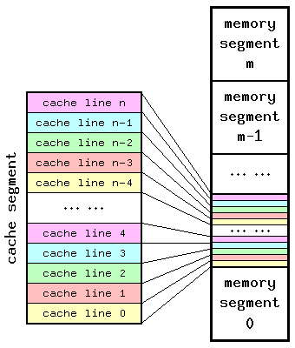
Cache Line
The minimum amount of cache which can be loaded or stored to memory
X86 CPUs
64 Bytes
ARM CPUs
32 Bytes
Cache Line Size Testing
Igor’s Blog：Example 2
Notes:
Performance Tuning for CPU. http://vdisk.weibo.com/s/Gc57-
Understanding the CPU Cache. https://wiki.csiro.au/display/ASC/Understanding+the+CPU+Cache

Slide 11
Cache Policy
Inclusive Multilevel Cache
外层Cache包含内层Cache的所有数据；
外部访问，只需访问最外层的Cache(L3)；
最常见形式
Exclusive Multilevel Cache
外层Cache可能不包含内存Cache的数据；
外部访问，需要遍历所有层级Cache(L1/L2/L3)，寻找记录；
选择原则
空间与效率之间的平衡；
Inclusive：浪费空间；效率高；
Exclusive：节约空间；效率低；
Notes:
Nehalem处理器的存储层次. http://www.itocp.com/html/core_i7_review/core_i7_review/arch/5_cache.html

Slide 12
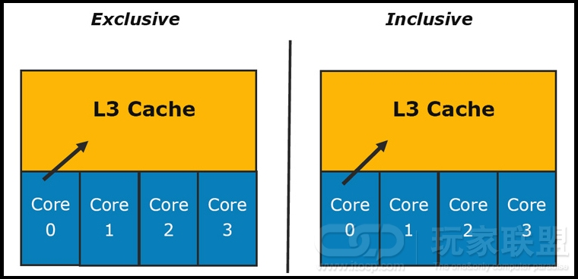
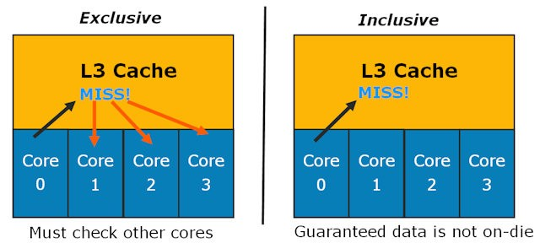
Cache Policy(续)

Slide 13
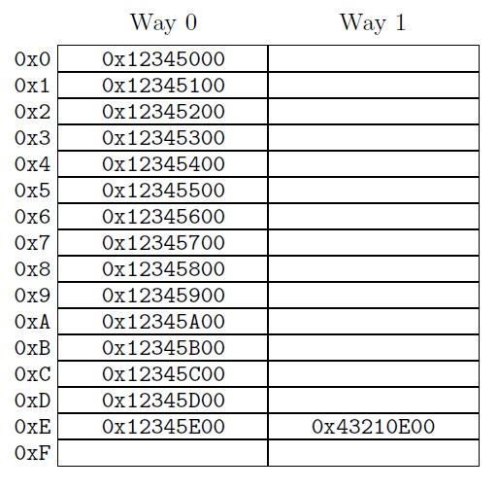
Cache Structure
Large caches are implemented as hardware hash tables with fixed-size hash buckets (or “sets”) and no chaining.
sets
hardware hash tables中的hash入口数量；
ways
每个hash入口能够存储的项数量；
N-way set associative cache
N = 1
Direct-Mapped Cache
N = 8
8-way set associative cache
N = cache size / cache line size
full associative cache
Notes:
Memory Barriers: a Hardware View for Software Hackers. http://www.rdrop.com/users/paulmck/scalability/paper/whymb.2010.06.14a.pdf
CPU cache. http://en.wikipedia.org/wiki/CPU_cache
Introduction of Cache Memory. http://www.cs.umd.edu/class/fall2001/cmsc411/proj01/cache/cache.html

Slide 14
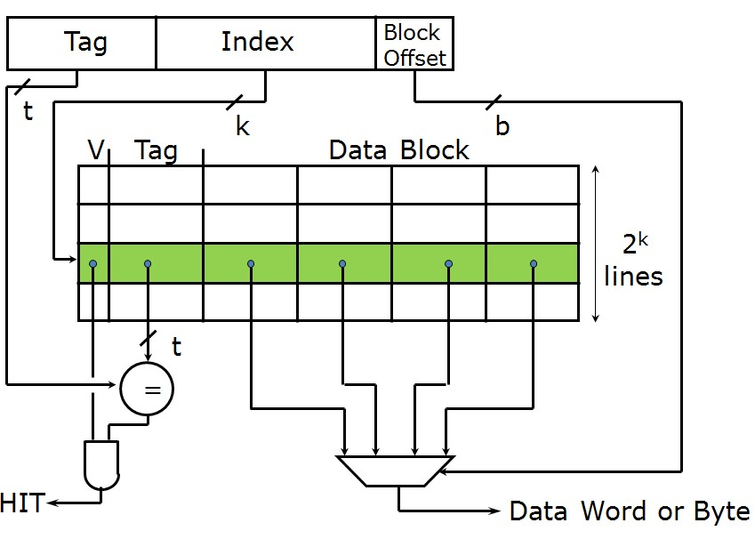
Direct-Mapped Cache

Slide 15
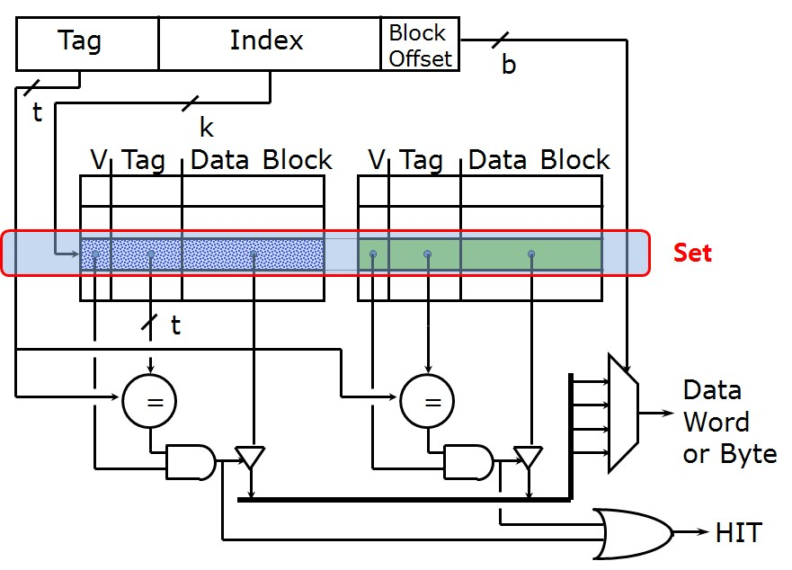
2-Way Associative Cache

Slide 16
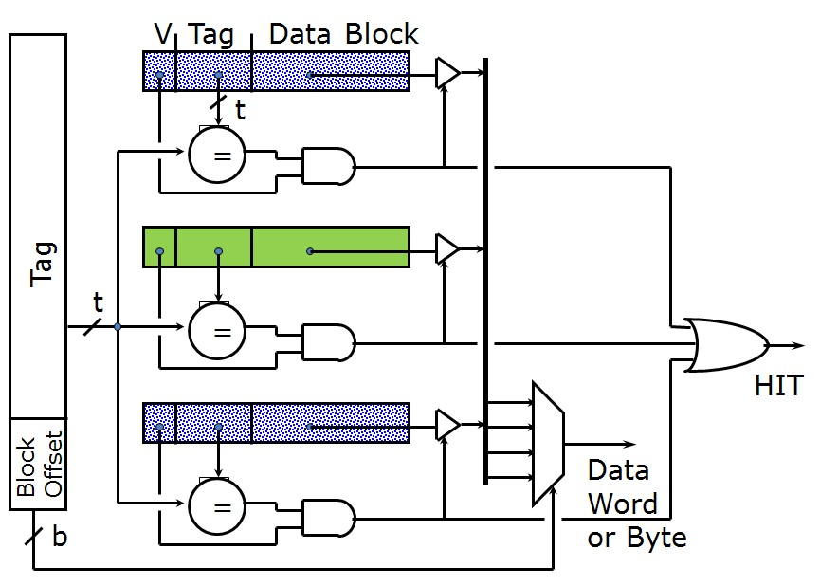
Full Associative Cache

Slide 17
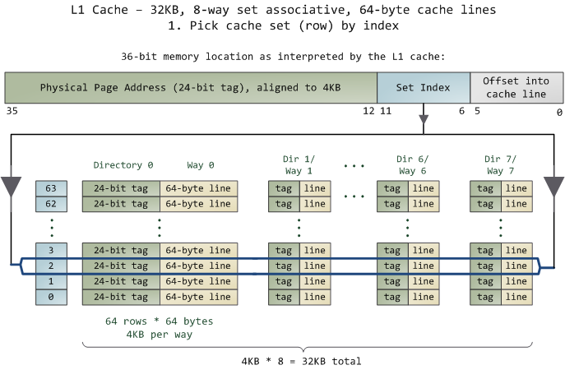
Cache Line Locate (1)
Notes:
Cache: a place for concealment and safekeeping. http://duartes.org/gustavo/blog/post/intel-cpu-caches
CPU cache. http://en.wikipedia.org/wiki/CPU_cache

Slide 18
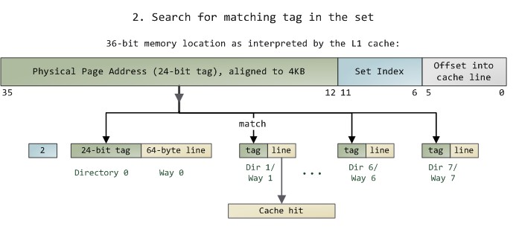
Cache Line Locate (2)
Virtual Address vs Physical Address
A memory access usually starts with a linear (virtual) address
tag vs index
index：used to locate set entry;
tag： used to find the correct cache line in the set;
PIPT vs VIPT
PIPT：Physically indexed， physically tagged
VIPT：Virtually indexed， physically tagged (L1 Cache)

Slide 19

Cache Associative分析
Direct-Mapped Cache
定位最快，冲突最严重；
2/4/8-Way Associative Cache
N值越大，冲突越低，定位越慢；
Full Associative Cache
冲突最低，定位最慢；
我的个人电脑
8-Way Associative L2 (2MB)
每个set大小
64 * 8 = 512 Bytes；
Sets = 2 MB/512 Bytes = 4096;
每隔4096 * 64B = 256KB的地址的Cache Line，就会在同一个Set中；
Notes:
Gallery of Processor Cache Effects. http://igoro.com/archive/gallery-of-processor-cache-effects/

Slide 20
Cache Coherence Problem
P
P
P
1
2
3
u
= ?
u
= ?
3
$
4
$
5
$
u
:5
u
:5
u
= 7
1
I/O devices
u
:5
2
Memory
Assumption: Write back scheme
Problem:
Processors see different values for u after event 3
Notes:
cache. http://vdisk.weibo.com/s/ItKHC PP158

Slide 21
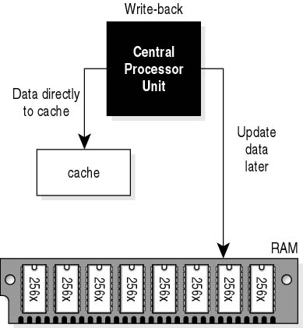
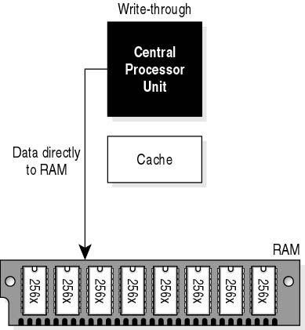
Cache Write Policy
Write Back vs Write Through
Write Back
脏数据，写出到Cache；
Write Miss
Read Cache Line；
Write Allocate；
Write Through
脏数据，写穿到Memory;
Write Hit
更新Cache；
Write Miss
绕过Cache，直接写memory;

Slide 22
Cache Write Policy(续)
Write Invalidate vs Write Update
Write Invalidate
Write时，同时发出Invalidate消息，使得所有其他CPU L1/L2 Cache中同一Cache Line失效；
优势：实现简单；
不足：会导致其他CPU再次读取时出现Cache Miss；
Write Update
Write时，同时更新其他CPU L1/L2 Cache中同一Cache Line；
优势：对应write Invalidate的不足；
不足：对应write invalidate的优势；
选择
目前，基本都是Write Invalidate方式

Slide 23
Solve Cache Coherence Problem(1)
Write-Through Invalidate
P
P
P
1
2
3
u
= ?
u
= ?
3
$
4
$
5
$
u
:5
u
:5
u
= 7
1
I/O devices
u
:5
2
Memory

Slide 24
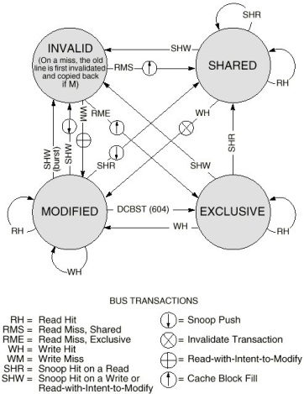
Solve Cache Coherence Problem(2)
MESI Protocol
4 States
Invalid
无数据
Shared
与Memory一致的数据；
多节点共享；
Exclusive
与Memory一致的数据；
单节点持有；
Modified
最新修改数据，与memory不一致；
单节点持有；
状态转移
见右图
Notes:
Optimizing the MESI Cache Coherence Protocol for Multithreaded Applications on Small Symmetric Multiprocessor Systems. http://tibrewala.net/papers/mesi98/
Memory Barriers: a Hardware View for Software Hackers. http://www.rdrop.com/users/paulmck/scalability/paper/whymb.2010.06.14a.pdf

Slide 25
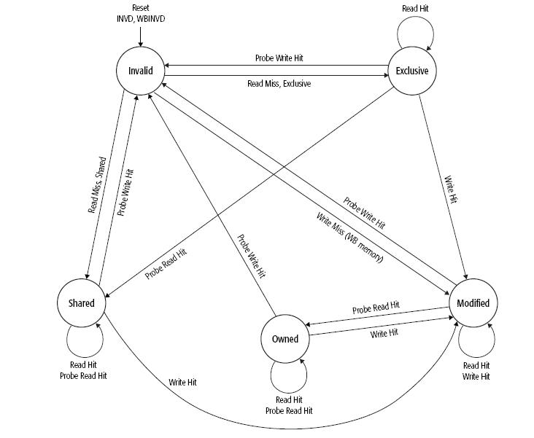
Solve Cache Coherence Problem(3)
MOESI Protocal (AMD)
5 states
Invalid
Shared
Exclusive
Modified
以上4种，与MESI一致；
Owned
介于Shared与Modified之间的
一种状态；
可与Shared的状态共存；
持有最新数据，Memory中则为
过期数据；
状态转移
见右图
Notes:
MOESI protocal. http://en.wikipedia.org/wiki/MOESI_protocol

Slide 26
Cache Coherence
注意
作用域
Cache Coherence Protocal (MESI, MOESI)，作用于CPU Cache与Memory层面，若操作的数据在Register，或者是Register与L1 Cache之间(后续提到的Store Buffer，Load Buffer)，则这些数据不会参与Cache Coherence协议；
Message
Cache Coherence协议中的Message，是由汇编指令触发的。一条高级语言(C/C++)，可能会被编译为多条汇编指令 (例如：a++ 至少被编译为3条汇编指令)；
一条汇编指令，可能会发出多条Messages。例如：一个Write操作，如果Cache Miss，会发出多条Messages：Read + Invalidate + ...

Slide 27
Any Question about CPU Cache?

Slide 28
Memory Consistency
Memory Consistency
Memory Consistency模型，是整个并发程序设计的基础。
并发程序设计分为4个阶段：
阶段一：知道什么是Spinlock，什么是Mutex，也知道访问共享资源需要进行保护；
阶段二：知道如何实现一个高性能的Spinlock，Mutex，以面对不同的需求；
阶段三：知道Spinlock，Mutex实现的内部原理是什么？为什么可以用来保护共享资源；
阶段四：在熟练使用锁的基础上，追求高性能，尝试Lock-Free编程；
而为了从阶段一，晋级到阶段二，三，甚至是阶段四，离不开对于Memory Consistency模型的深入理解。本PPT关于Memory Consistency的内容，按照如下方式组织：
Atomic vs Reorder
讨论什么是Atomic Operation？讨论程序有哪些乱序行为？
Memory Barrier
何谓Memory Barrier？Memory Barrier有哪些种类？Memory Barrier如何使用？
Load Acquire vs Store Release
Load Acquire与Store Release，是什么意思？

Slide 29
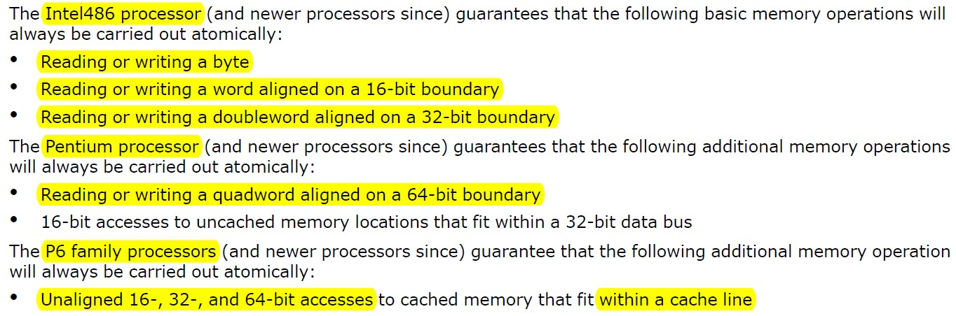
Atomic Operation
An operation acting on shared memory is atomic if it completes in a single step relative to other threads. When an atomic store is performed on a shared variable, no other thread can observe the modification half-complete. When an atomic load is performed on a shared variable, it reads the entire value as it appeared at a single moment in time.
Atomic Operation in CPU
Intel CPU
AMD CPU
Notes:
Atomic vs. Non-Atomic Operations. http://preshing.com/20130618/atomic-vs-non-atomic-operations
Lockless Programming Considerations for Xbox 360 and Microsoft Windows. http://msdn.microsoft.com/en-us/library/windows/desktop/ee418650(v=vs.85).aspx
Intel 64 and IA-32 Architectures Software Developer’s Manual Volume 3A: System Programming Guide, Part 1 http://download.intel.com/products/processor/manual/253668.pdf Chapter 8.1.1
AMD64 Architecture Programmer’s Manual Volume 1: Application Programming. http://support.amd.com/us/Processor_TechDocs/24592_APM_v1.pdf [Search for Atomic]

Slide 30


高级语言与汇编指令的映射
高级语言(如：C/C++)，被编译为汇编语言，才能够被执行。因此，高级语言与汇编语言之间，存在着几种简单的映射关系。
Simple Write
Write to Memory
Atomic
Simple Read
Read from Memory
Atomic
Read-Modify-Write(RMW)
Read from Memory
Modify
Write to Memory
Non-Atomic

Slide 31
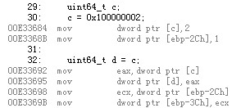
Non-Atomic Operations
Examples
Read/Write 64 Bits on 32 Bits Systems
Write：Non-Atomic
Read：Non-Atomic
RMW Operations
Non-Atomic

Slide 32
Non-Atomic Operations(续)
Questions?
32位系统，是否4 Bytes的Simple Read/Write一定是Atomic？
64位系统，是否8 Bytes的Simple Read/Write一定是Atomic？
Exceptions
Intel486 and newer [参考Igor文章的Example 3，查询CPU类型工具]
Unaligned 16-, 32-bit access;
Pentium and newer
Unaligned 16-, 32-, 64-bit access;
P6 and newer
Cross cache line access; (注意：P6 and newer CPU，允许Atomic Unaligned access)
AMD
Unaligned 16-, 32-, 64-bit access;
ARM
strd instruction...
Notes:
Atomic vs. Non-Atomic Operations. http://preshing.com/20130618/atomic-vs-non-atomic-operations
Intel 64 and IA-32 Architectures Software Developer’s Manual Volume 3A: System Programming Guide, Part 1 http://download.intel.com/products/processor/manual/253668.pdf Chapter 8.1.1
AMD64 Architecture Programmer’s Manual Volume 1: Application Programming. http://support.amd.com/us/Processor_TechDocs/24592_APM_v1.pdf [Search for Atomic]

Slide 33
Non-Atomic的危害
Half Write
mov dword ptr [c], 2执行后，
会短暂出现c的half write现象；
Half Read
若c出现half write，则读取c
会出现half read现象；
Composite Write
两个线程同时write c，一个完成，一个half write，则c的值，来自线程1，2两个write操作的组合；
危害
出现Half Read，会导致程序判断逻辑出错；
出现Composite Write，会导致数据出错；

Slide 34
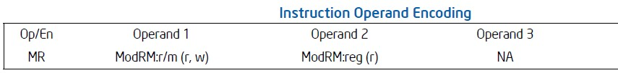
Atomic Instructions and Lock(1)
Atomic Instructions
常见指令：CMPXCHG，XCHG，XADD，...
CMPXCHG (compare-and-exchange)
将Operand 1(Reg/Mem)中的内容与EAX比较，若相等，则拷贝Operand 2(Reg)中的内容至Operand 1；若不等，则将Operand 2中的数据写入EAX；
一个Atomic RMW操作，若Operand 1为Memory，则CMPXCHG指令还需要Lock指令配合 (Lock prefix)；
Notes:
Intel 64 and IA-32 Architectures Software Developer’s Manual Volume 2 (2A, 2B & 2C): Instruction Set Reference, A-Z. http://download.intel.com/products/processor/manual/325383.pdf [Search for cmpxchg, xchg, lock]

Slide 35
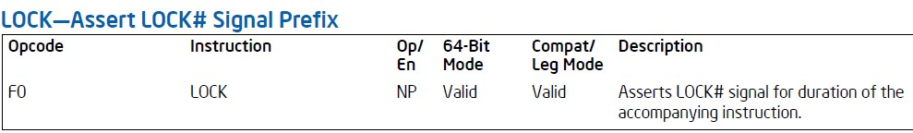
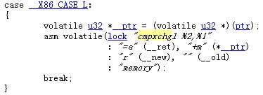
Atomic Instructions and Lock(2)
Lock Instruction
Lock指令是一个前缀，可以用在很多指令之前，代表当前指令所操作的内存(Memory)，在指令执行期间，只能被当前CPU所用；
Question: 若指令没有操作内存，那么Lock前缀还有意义吗？
Intel’s Description about Lock Instruction
Lock with CMPXCHG
Notes:
Intel 64 and IA-32 Architectures Software Developer’s Manual Volume 2 (2A, 2B & 2C): Instruction Set Reference, A-Z. http://download.intel.com/products/processor/manual/325383.pdf [Search for cmpxchg, xchg, lock]
Inline Assembly. http://wiki.osdev.org/Inline_Assembly
cmpxchg.h in Linux. http://tomoyo.sourceforge.jp/cgi-bin/lxr/source/arch/x86/include/asm/cmpxchg.h

Slide 36
Non-Atomic消除
如何消除Non-Atomic Read/Write？
平台方面 (参考各CPU白皮书)
Intel/AMD CPU
Aligned 2-，4-Byte Simple Read/Write → Atomic
Aligned 8-Byte，CPU型号 → 一般为Atomic
Unaligned 2-, 4-, 8-Byte，CPU型号判断 → 尽量少用
其他
RMW Operation
尽量使用系统自带的，或者是提供的原子操作函数；这些函数，对不同CPU类型，做了较好的封装，更加易用；
Windows Synchronization Functions
Linux Built-in Functions for Atomic Memory Access
C++ 11 Atomic Operations Library

Slide 37
Any Question about Atomic?

Slide 38
Memory Ordering(Reordering)
Reordering
Reads and writes do not always happen in the order that you have written them in your code.
Why Reordering
Performance
Reordering Principle
In single threaded programs from the programmer's point of view, all operations appear to have been executed in the order specified, with all inconsistencies hidden by hardware.
一段程序，在Reordering前，与Reordering后，拥有相同的执行效果(Single Thread)
Notes:
Memory Ordering. http://en.wikipedia.org/wiki/Memory_ordering
Lockless Programming Considerations for Xbox 360 and Microsoft Windows. http://msdn.microsoft.com/en-us/library/windows/desktop/ee418650(v=vs.85).aspx
Intel 64 and IA-32 Architectures Software Developer’s Manual Volume 3A: System Programming Guide, Part 1. http://download.intel.com/products/processor/manual/253668.pdf [Chapter 8.2.2]
AMD64 Architecture Programmer’s Manual Volume 2: System Programming. http://support.amd.com/us/Processor_TechDocs/24593_APM_v2.pdf [Chapter 7]

Slide 39
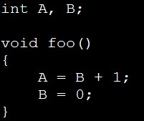



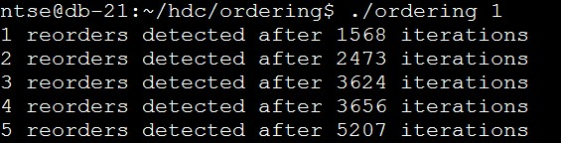
Reordering
Examples
Example 1
A, B 赋值操作被Reorder；
Example 2
假设X，Y初始化为0；
Question：那么Load X，Y，会得到X，Y均为0吗？
Test Code & Test Result
Notes:
Memory Ordering at Compile Time. http://preshing.com/20120625/memory-ordering-at-compile-time
Memory Reordering Caught in the Act. http://preshing.com/20120515/memory-reordering-caught-in-the-act
Who ordered memory fences on an x86? http://bartoszmilewski.com/2008/11/05/who-ordered-memory-fences-on-an-x86/

Slide 40
Reordering-Type
Compiler Reordering
Example 1，出现在编译期间的Reordering，称之为Compiler Reordering；
CPU Memory Ordering
Example 2，出现在执行期间的Reordering，称之为CPU Memory Ordering；
用户程序，无论是在编译期间，还是在执行期间，都会产生Reordering；

Slide 41
Compiler Reordering & Compiler Memory Barrier
Compiler Reordering能够提高程序的运行效率。但有时候 (尤其是针对Parallel Programming)，我们并不想让Compiler将我们的程序进行Reordering。此时，就需要有一种机制，能够告诉Compiler，不要进行Reordering，这个机制，就是Compiler Memory Barrier。
Memory Barrier
A memory barrier, is a type of barrier instruction which causes a central processing unit (CPU) or compiler to enforce an ordering constraint on memory operations issued before and after the barrier instruction. This typically means that certain operations are guaranteed to be performed before the barrier, and others after.
Compiler Memory Barrier
顾名思义，Complier Memory Barrier就是阻止Compiler进行Reordering的Barrier Instruction；
Notes:
Memory barrier. http://en.wikipedia.org/wiki/Memory_barrier
Memory ordering. http://en.wikipedia.org/wiki/Memory_ordering
Memory Barriers a Hardware View for Software Hackers. http://www.rdrop.com/users/paulmck/scalability/paper/whymb.2009.04.05a.pdf

Slide 42
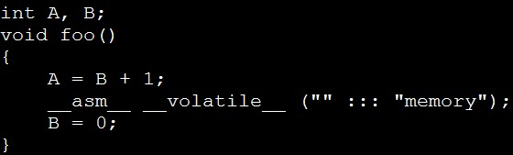
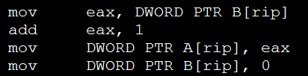
Compiler Memory Barrier
Compiler Memory Barrier Instructions
GNU
asm volatile("" ::: "memory");
__asm__ __volatile__ ("" ::: "memory");
Intel ECC Compiler
__memory_barrier();
Microsoft Visual C++
_ReadWriteBarrier();
使用Compiler Memory Barrier后的效果
乱序消失；

Slide 43
Compiler Memory Barrier
注意：
Compiler Memory Barrier只是一个通知的标识，告诉Compiler在看到此指令时，不要对此指令的上下部分做Reordering。
在编译后的汇编中，Compiler Memory Barrier消失，CPU不能感知到Compiler Memory Barrier的存在，这点与后面提到的CPU Memory Barrier有所不同；

Slide 44
CPU Memory Ordering
Definition
The term memory ordering refers to the order in which the processor issues reads(loads) and writes(stores) through the system bus to system memory. (From Intel System Programming Guide 8.2)
Some Questions
为什么需要reordering？
1: L1 Latency 4 clks; L2 10 clks; L3 20 clks; Memory 200 clks → Huge Latency
2: 考虑指令执行时，read与write的优先级；(CPU设计时，重点考虑)
有哪些Reordering情况？不同的CPU，支持哪些Reordering？

Slide 45

CPU Reordering Types
2 Instructions
2 operation types：read(load) and write(store)
4 CPU Reordering Types
LoadLoad
读读乱序
LoadStore
读写乱序
StoreLoad
写读乱序
StoreStore
写写乱序
Notes:
Memory Barriers Are Like Source Control Operations. http://preshing.com/20120710/memory-barriers-are-like-source-control-operations

Slide 46
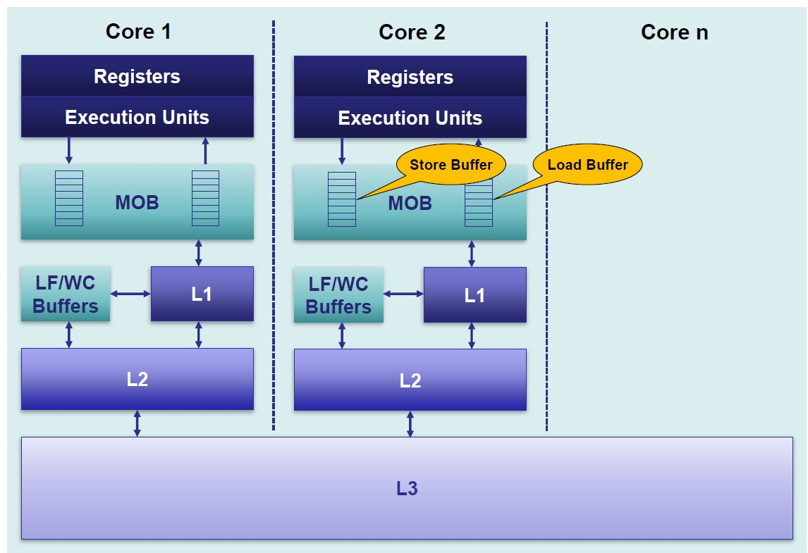
扩展知识：CPU如何实现Memory Reordering
Buffer and Queue
Load/Store Buffer；Line Fill Buffer/Write Combining Buffer；Invalidate Message Queue；...
深入了解，见下面列出的参考资料
Notes:
Intel Sandy Bridge Configuration. http://www.7-cpu.com/cpu/SandyBridge.html
Intel’s Haswell CPU Microarchitecture. http://www.realworldtech.com/haswell-cpu/5/
CPU Cache Flushing Fallacy. http://mechanical-sympathy.blogspot.com/2013/02/cpu-cache-flushing-fallacy.html
Memory Barriers/Fences. http://mechanical-sympathy.blogspot.com/2011/07/memory-barriersfences.html
Write Combining. http://mechanical-sympathy.blogspot.com/2011/07/write-combining.html

Slide 47
CPU Memory Models
Definitions
Memory consistency models describe how threads may interact through shared memory consistently.
There are many types of memory reordering, and not all types of reordering occur equally often. It all depends on processor you’re targeting and/or the tool chain you’re using for development.
主要的CPU Memory Models (Memory Consistency)
Sequential Consistency (SC) Strong
Total Store Order Model (TSO)
Data Dependency Order Weak
...
Notes:
Lock-Free Algorithms. http://qconlondon.com/dl/qcon-london-2012/slides/MartinThompson_and_MichaelBarker_LockFreeAlgorithmsForUltimatePerformance.pdf PP9
Weak vs. Strong Memory Models. http://preshing.com/20120930/weak-vs-strong-memory-models

Slide 48
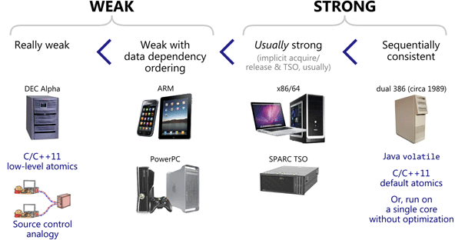
CPU Memory Models
Notes:
Weak vs. Strong Memory Models. http://preshing.com/20120930/weak-vs-strong-memory-models

Slide 49
Intel X86/64 Memory Model(1)
In a single-processor system for memory regions defined as write-back cacheable.
Reads are not reordered with other reads.
Writes are not reordered with older reads.
Writes to memory are not reordered with other writes.
Reads may be reordered with older writes to different locations but not with older writes to the same location.
注：以下部分，稍后分析
Reads or writes cannot be reordered with I/O instructions, locked instructions, or serializing instructions.
Reads cannot pass earlier LFENCE and MFENCE instructions.
Writes cannot pass earlier LFENCE, SFENCE, and MFENCE instructions.
LFENCE instructions cannot pass earlier reads.
SFENCE instructions cannot pass earlier writes.
MFENCE instructions cannot pass earlier reads or writes.

Slide 50
Intel X86/64 Memory Model(2)
In a multiple-processor system
Individual processors use the same ordering principles as in a single-processor system.
Writes by a single processor are observed in the same order by all processors.
Writes from an individual processor are NOT ordered with respect to the writes from other processors.
Memory ordering obeys causality (memory ordering respects transitive visibility).
Any two stores are seen in a consistent order by processors other than those performing the stores.
注：以下部分，稍后分析
Locked instructions have a total order.

Slide 51
Intel X86/64 Memory Model(3)
解读
普通内存操作，只可能存在StoreLoad Reordering；
LoadLoad、LoadStore、StoreStore均不可能Reordering；
一个Processor的Writes操作，其他Processor看到的顺序是一致的；(TSO)
不同Processors的Writes操作，是没有顺序保证的；
StoreLoad Reordering Problem
Failure of Dekker’s algorithm
Test Code

Slide 52
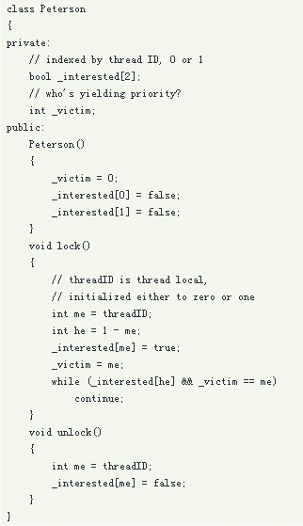
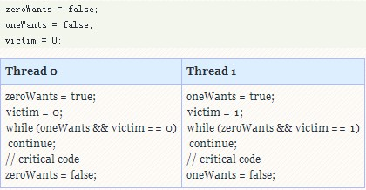
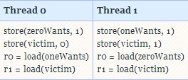
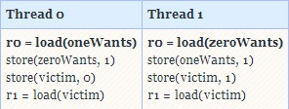
StoreLoad Reordering Problem
Peterson Lock
Notes:
Who ordered memory fences on an x86? http://bartoszmilewski.com/2008/11/05/who-ordered-memory-fences-on-an-x86/

Slide 53
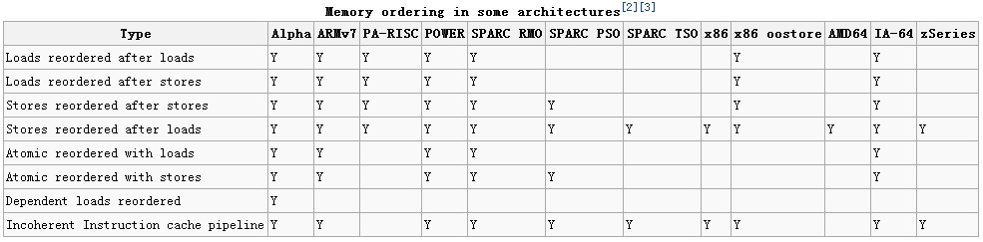
What About Other CPUs?
So you know why we call X86, AMD64 as Strong-Ordered (Total Store Order, TSO).
Notes:
Memory ordering. http://en.wikipedia.org/wiki/Memory_ordering

Slide 54
How to Prevent CPU Memory Reordering
Think about Compiler Memory Barrier
asm volatile("" ::: "memory");
__asm__ __volatile__ ("" ::: "memory");
Memory Barrier Definition
A memory barrier, is a type of barrier instruction which causes a central processing unit (CPU) or compiler to enforce an ordering constraint on memory operations issued before and after the barrier instruction. This typically means that certain operations are guaranteed to be performed before the barrier, and others after.
CPU Memory Barrier
顾名思义，Compiler Memory Barrier既然是用来告诉Compiler在编译阶段不要进行指令乱排，那么CPU Memory Barrier就是用来告诉CPU，在执行阶段不要交互两条操作内存的指令的顺序；
注意：由于CPU在执行时，必须感知到CPU Memory Barrier的存在，因此CPU Memory Barrier是一条真正的指令，存在于编译后的汇编代码中；

Slide 55
CPU Memory Types(theoretical)
面临的问题
4种CPU Memory Reordering
LoadLoad, LoadStore, StoreLoad, StoreStore
4种基本的CPU Memory Barriers
LoadLoad Barrier
LoadStore Barrier
StoreLoad Barrier
StoreStore Barrier
更为复杂的CPU Memory Barriers
Store Barrier (Write Barrier)
所有在Store Barrier前的Store操作，必须在Store Barrier指令前执行完毕；而所有Store Barrier指令后的Store操作，必须在Store指令执行结束后才能开始；
Store Barrier只针对Store(Write)操作，对Load无任何影响；
Load Barrier (Read Barrier)
将Store Barrier的功能，全部换为针对Load操作即可；
Full Barrier
Load + Store Barrier，Full Barrier两边的任何操作，均不可交换顺序；

Slide 56
Memory Barrier Instructions in CPU
x86, x86-64, amd64
lfence： Load Barrier
sfence： Store Barrier
mfence： Full Barrier
PowerPC
sync： Full Barrier
MIPS
sync： Full Barrier
Itanium
mf： Full Barrier
ARMv7
dmb
dsb
isb
Notes:
Memory ordering. http://en.wikipedia.org/wiki/Memory_ordering
Intel 64 and IA-32 Architectures Software Developer's Manual Volume 3 (3A, 3B & 3C) System Programming Guide. http://download.intel.com/products/processor/manual/325384.pdf [Chapter 8.2.5]

Slide 57
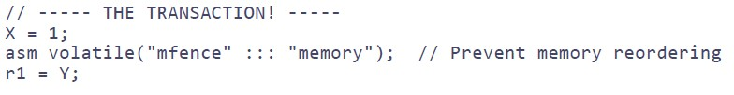
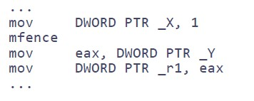
Use CPU Memory Barrier Instructions(x86)
Only CPU Memory Barrier
asm volatile(“mfence”);
CPU + Compiler Memory Barrier
asm volatile(“mfence” ::: ”memory”);
Use Memory Barrier in C/C++

Slide 58
Yes！We Need Lock Instruction’s Help！
Question？
除了CPU本身提供的Memory Barrier指令之外，是否有其他的方式实现Memory Barrier？
Yes! We Need Lock Instruction’s Help!
Reads or writes cannot be reordered with I/O instructions, locked instructions, or serializing instructions.
解读
既然read/write不能穿越locked instructions进行reordering，那么所有带有lock prefix的指令，都构成了一个天然的Full Memory Barrier；

Slide 59
Use Lock Instruction to Implement a MB
lock addl
asm volatile("lock; addl $0,0(%%esp)" ::: "memory")
addl $0,0(%%esp) → do nothing
lock; → to be a cpu memory barrier
“memory” → to be a compiler memory barrier
xchg
asm volatile(“xchgl (%0),%0” ::: “memory”)
Question: why xchg don’t need lock prefix?
Answer: The LOCK prefix is automatically assumed for XCHG instruction.
lock cmpxchg
Do it yourself
Notes:
Which is a better write barrier on x86: lock+addl or xchgl? http://stackoverflow.com/questions/4232660/which-is-a-better-write-barrier-on-x86-lockaddl-or-xchgl
Understanding the Linux Kernel, 3rd Edition. PP208
Memory barriers. http://www.crashcourse.ca/wiki/index.php/Memory_barriers
Runtime memory barrier patching. http://lwn.net/Articles/29599/

Slide 60
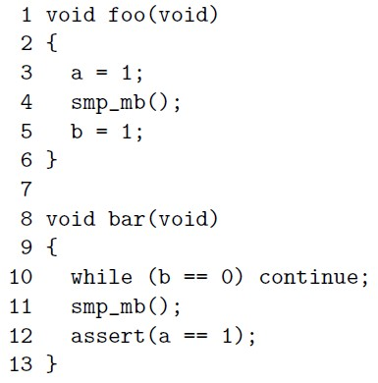
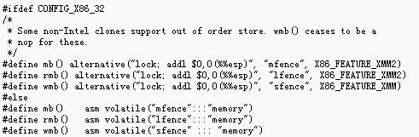
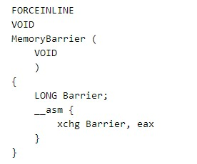
Memory Barriers in Compiler & OS
Linux(x86, x86-64)
smp_rmb()
smp_wmb()
smp_mb()
Windows(x86, x86-64)
MemoryBarrier()
Notes:
Memory barriers. http://www.crashcourse.ca/wiki/index.php/Memory_barriers
Memory Barrier macro. http://msdn.microsoft.com/en-us/library/windows/desktop/ms684208(v=vs.85).aspx

Slide 61
X86 Memory Ordering with Memory Barrier(1)
In a single-processor system for memory regions defined as write-back cacheable.
Reads are not reordered with other reads.
Writes are not reordered with older reads.
Writes to memory are not reordered with other writes.
Reads may be reordered with older writes to different locations but not with older writes to the same location.
注：新增部分
Reads or writes cannot be reordered with I/O instructions, locked instructions, or serializing instructions.
Reads cannot pass earlier LFENCE and MFENCE instructions.
Writes cannot pass earlier LFENCE, SFENCE, and MFENCE instructions.
LFENCE instructions cannot pass earlier reads.
SFENCE instructions cannot pass earlier writes.
MFENCE instructions cannot pass earlier reads or writes.

Slide 62
X86 Memory Ordering with Memory Barrier(2)
In a multiple-processor system
Individual processors use the same ordering principles as in a single-processor system.
Writes by a single processor are observed in the same order by all processors.
Writes from an individual processor are NOT ordered with respect to the writes from other processors.
Memory ordering obeys causality (memory ordering respects transitive visibility).
Any two stores are seen in a consistent order by processors other than those performing the stores.
注：新增部分
Locked instructions have a total order.

Slide 63


Read Acquire vs Write Release(1)
Read Acquire and Write Release
Two Special Memory Barriers.
Definition
A read-acquire executes before all reads and writes
by the same thread that follow it in program order.
A write-release executes after all reads and writes
by the same thread that precede it in program order.
Question
Read Acquire and Write Release 有何作用？
Notes:
Lockless Programming Considerations for Xbox 360 and Microsoft Windows. http://msdn.microsoft.com/en-us/library/windows/desktop/ee418650(v=vs.85).aspx
Acquire and Release Semantics. http://preshing.com/20120913/acquire-and-release-semantics

Slide 64
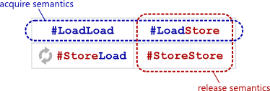

Read Acquire vs Write Release(2)
Read Acquire and Write Release Barriers
Read Acquire
LoadLoad + LoadStore Barrier
Write Release
LoadStore + StoreStore Barrier
解读
Read Acquire + Write Release语义，是所有锁实现的基础(Spinlock, Mutex, RWLock, ...)，所有被[Read Acquire, Write Release]包含的区域，即构成了一个临界区，临界区内的指令，确保不会在临界区外运行。因此，Read Acquire又称为Lock Acquire，Write Release又称为Unlock Release；

Slide 65
How to Implement Read Acquire/Write Release?
Intel X86, X86-64
Full Memory Barrier
mfence
locked instruction
Compiler and OS
Linux
smp_mb()
Windows
Functions with Acquire/Release Semantics
InterlockedIncrementAcquire ()...

Slide 66
Extension：StoreLoad Reorder
Question
为什么Intel CPU在LoadLoad，LoadStore，StoreLoad，StoreStore乱序中，仅仅保持了StoreLoad乱序？
为什么， LoadLoad/LoadStore/StoreStore Barrier乱序被称之为lightweight Barrier? 而StoreLoad Barrier则为Expensive Barrier？
on PowerPC, the lwsync (short for “lightweight sync”) instruction acts as all three #LoadLoad, #LoadStore and #StoreStore barriers at the same time, yet is less expensive than the sync instruction, which includes a #StoreLoad barrier.
Answer
Store Buffer;
Store异步不影响指令执行；
Load只能同步；
注意
Intel CPU，Load自带Acquire Semantics；Store自带Release Semantics；

Slide 67
Any Question about Memory Ordering?

Slide 68
并发程序设计
在充分理解了CPU Cache架构，以及Memory Ordering之后，开始进行并发程序设计与实现，就显得水到渠成；
本部分的内容
实现一个自己的Spinlock；
一个真实的案例；
volatile：C++ vs Java；
探讨并发程序设计中的一些优化建议；

Slide 69
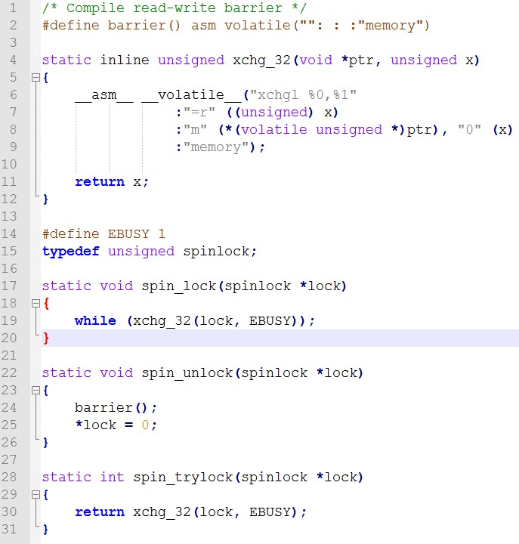
Implement a Spinlock
Simplest Spinlock
From Lockless
解读
功能
给定一个unsigned值，0代表未加锁，
1代表加锁；只有一个能加锁成功；
spin_lock
xchg
implicit lock instruction
spin_unlock
asm volatile(“”: : :”memory”)
Load Acquire
locked instruction = full barrier
Write Release
compile barrier；
X86；No LoadStore, StoreStore Reorder;
Notes:
Spinning. http://www.1024cores.net/home/lock-free-algorithms/tricks/spinning
Spinlocks and Read-Write Locks. http://locklessinc.com/articles/locks/

Slide 70
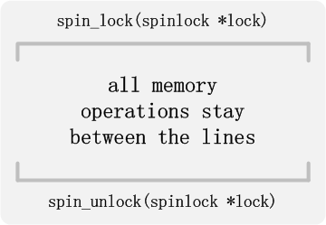
Simplest Spinlock分析(1)
功能上
保证同一时间，只有一个线程能够spin_lock成功，其余线程全部堵在while循环；
spin_lock实现了Load Acquire Semantics；
spin_unlock实现了Write Release Semantics；
功能上：Success
成功应用了前面的多个知识点
Intel Memory Ordering Model；
CPU Memory Barrier
Atomic Instruction
Locked Instruction
Compile Memory Barrier
Load Acquire
Store Release

Slide 71
Simplest Spinlock分析(2)
性能上
此Simplest Spinlock有很多问题，可以进行优化，集中在spin_lock()函数；
问题分析(参考)
1. 根据predict，CPU发现xchg_32函数极少会返回0(Success)，因此将会采用speculative execution，CPU流水线中充满xchg指令，消耗CPU；
2. 由于流水线中充斥着speculative xchg指令，因此当xchg返回0(Success)，投机失败惩罚较大，尤其是针对长流水线；
3. 若其他CPU长时间持有spin_lock，则当前CPU无法释放资源给其他程序运行；
4. xchg指令，用在此处效率不高；
Notes:
pause instruction in x86. http://stackoverflow.com/questions/12894078/pause-instruction-in-x86
Spinning. http://www.1024cores.net/home/lock-free-algorithms/tricks/spinning

Slide 72
Simplest Spinlock改进
针对问题1，2
引入pause指令；
asm volatile ("pause");
部分平台，不支持pause，可用rep; nop替代；
pause指令功能
通知CPU，当前处于spinlock函数调用之中，消除speculative ，降低CPU消耗，加锁成功后，无需处理失败的speculative指令，性能更高；
在超线程下，空闲出来的CPU流水线，可以交给另一个线程使用，提高CPU利用率；
针对问题3
若处理临界区的时间较长，spinlock可从Active模式逐渐退化为Passive模式；
Active
不释放CPU资源，反复尝试；
Passive
释放CPU资源，进入Sleep，甚至等待唤醒；
针对问题4
xchg指令每次都会修改内存，使用更为高效的cmpxchg替代；
Notes:
pause instruction in x86. http://stackoverflow.com/questions/12894078/pause-instruction-in-x86

Slide 73
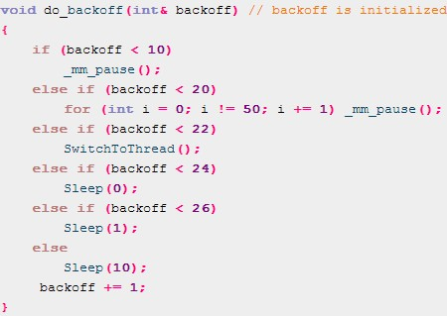
Spinlock：Active vs Passive
Spinning.
Active
Only pause, not release CPU
pause(); _mm_pause();
Passive
Release CPU to System, but not Sleep
pthread_yield(); SwitchToThread(); Sleep(0);
Release CPU to System, and Sleep
Sleep(n);
Hybrid
Active + Passive
主流实现方式

Slide 74
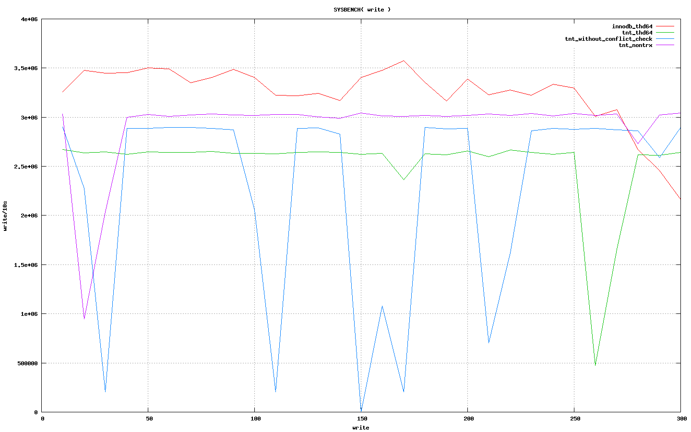
一个真实案例
案例来源
TNT/NTSE引擎为了高效率，实现了自己的Mutex；
进行Sysbench Insert测试的效果：TPS

Slide 75
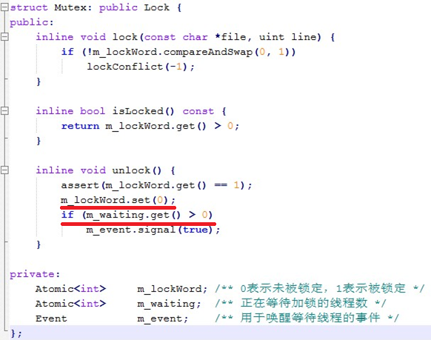
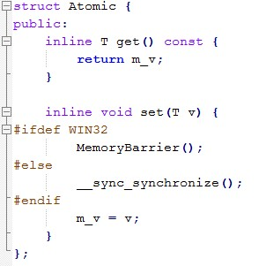
一个真实案例(续)
案例分析(Mutex部分实现)

Slide 76
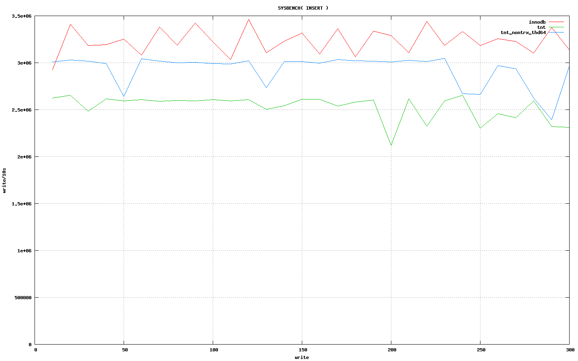
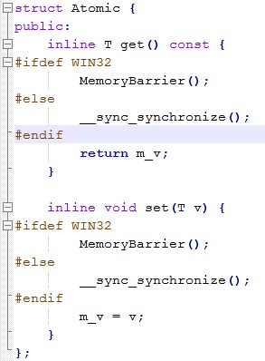
一个真实案例(续)
解决方案/效果

Slide 77
Volatile：C/C++ vs Java (1)
Volatile
易失的，不稳定的...
Volatile in C/C++
The volatile keyword is used on variables that may be modified simultaneously by other threads. This warns the compiler to fetch them fresh each time, rather than caching them in registers. (read/write actually happens)
No reordering occurs between different volatile reads/writes. (only volatile variables guarantee no reordering)
Volatile in Java
(The Same as C/C++)，Plus
Volatile reads and writes establish a happens-before relationship, much like acquiring and releasing a mutex. (no reordering takes place)
Read Volatile：Acquire Semantics；Write Volatile：Release Semantics；
Writes and reads of volatile long and double values are always atomic.
The Java Language Specification Java SE 7 Edition：Chapter 17.7
Notes:
Volatile variable. http://en.wikipedia.org/wiki/Volatile_variable
What are we going to do about volatile? http://www.complang.tuwien.ac.at/anton/euroforth/ef11/papers/haley.pdf
Who ordered sequential consistency? http://bartoszmilewski.com/tag/volatile/
The JSR-133 Cookbook for Compiler Writers. http://gee.cs.oswego.edu/dl/jmm/cookbook.html
What Volatile Means in Java. http://jeremymanson.blogspot.com/2008/11/what-volatile-means-in-java.html
The Java Language Specification Java SE 7 Edition. http://docs.oracle.com/javase/specs/jls/se7/jls7.pdf
Why the “volatile” type class should not be used. https://www.kernel.org/doc/Documentation/volatile-considered-harmful.txt
C++ and the Perils of Double-Checked Locking. http://www.aristeia.com/Papers/DDJ_Jul_Aug_2004_revised.pdf
volatile : Java Glossary. http://mindprod.com/jgloss/volatile.html
Volatile fields. http://msdn.microsoft.com/en-us/library/aa645755(v=vs.71).aspx
volatile (C++). http://msdn.microsoft.com/en-us/library/12a04hfd.aspx
volatile vs. volatile. http://www.drdobbs.com/parallel/volatile-vs-volatile/212701484?pgno=1
Why is volatile not considered useful in multithreaded C or C++ programming? http://stackoverflow.com/questions/2484980/why-is-volatile-not-considered-useful-in-multithreaded-c-or-c-programming

Slide 78
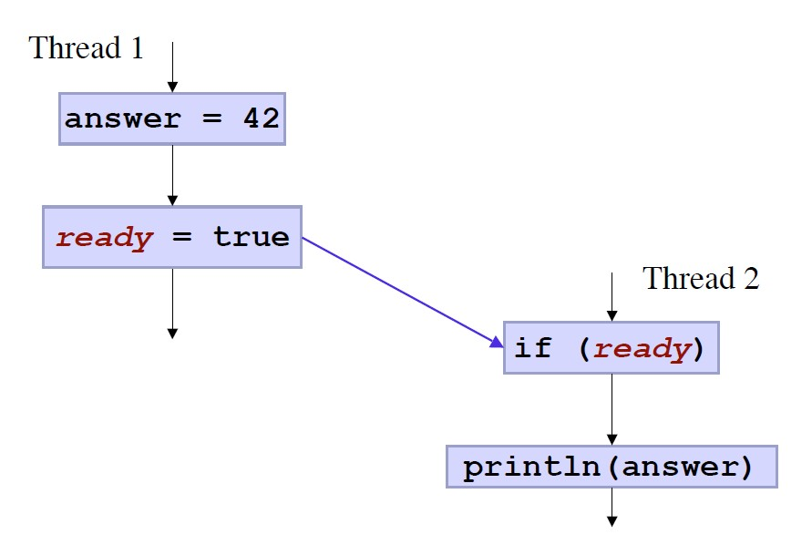
Volatile：C/C++ vs Java (2)
Examples
int answer = 0;
bool volatile ready;
Question
Thread 2的answer会输出什么结果？
C/C++
answer = 42 or 0，均有可能；
Java
answer = 42，只有唯一的结果；
Why？
Java’s Volatile：Write Release Semantics → ready(true)一定在answer(42)之后执行；

Slide 79
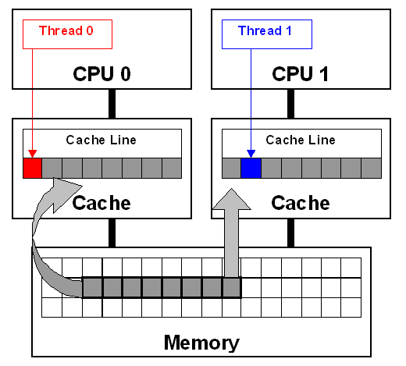

Others
False Sharing
Distributed Read-Write Mutex
Per-Processor Data

Slide 80
Parallel Programming，未完待续...

Slide 81
Reference-综合
A Primer on Memory Consistency and Cache Coherence. (Synthesis Lectures on Computer Architecture)
Intel 64 and IA-32 Architectures Software Developer’s Manual Combined Volumes:1, 2A, 2B, 2C, 3A, 3B, and 3C
AMD64 Architecture Programmers Manual Volume 1 System Programming
AMD64 Architecture Programmers Manual Volume 2 System Programming
MYTHBUSTING MODERN HARDWARE TO GAIN “MECHANICAL SYMPATHY”
Performance Tuning for CPU(Marat Dukhan)
Understanding The Linux Kernel 3rd Edition
Working Draft, Standard for Programming Language C++
The Art of Multiprocessor Programming
Nehalem - Everything You Need to Know about Intel's New Architecture
Intel Core i7 (Nehalem): Architecture By AMD?

Slide 82
Reference-CPU Cache
Cache Coherence Protocols
高速缓存（Cache Memory）
Cache(268 Pages)
Cache: a place for concealment and safekeeping
Gallery of Processor Cache Effects
Getting Physical With Memory
Intel’s Haswell CPU Microarchitecture
Introduction of Cache Memory
CPU Cache Flushing Fallacy
Multiprocessor Cache Coherence
Understanding the CPU Cache
What Every Programmer Should Know About Memory - Akkadia.org
What Programmer Should Know about Memory Consistence

Slide 83
Reference-Atomic
An attempt to illustrate differences between memory ordering and atomic access
Anatomy of Linux synchronization methods
Atomic Builtins - Using the GNU Compiler Collection (GCC)
Atomic vs. Non-Atomic Operations
Understanding Atomic Operations
Validating Memory Barriers and Atomic Instructions

Slide 84
Reference-Memory Ordering(1)
Acquire and Release Semantics
An attempt to illustrate differences between memory ordering and atomic access
what is a store buffer?
Which is a better write barrier on x86: lock+addl or xchgl?
Relative performance of swap vs compare-and-swap locks on x86
difference in mfence and asm volatile (“” : : : “memory”)
Inline Assembly
Intel memory ordering, fence instructions, and atomic operations.
Intel’s ‘cmpxchg’ instruction
Lockless Programming Considerations for Xbox 360 and Microsoft Windows
Write Combining
Memory barriers: a hardware view for software hackers
Memory Barriers Are Like Source Control Operations
Memory Ordering at Compile Time
Memory Reordering Caught in the Act
Memory barriers - The Linux Kernel Archives
Understanding Memory Ordering
Weak vs. Strong Memory Models
Who ordered memory fences on an x86?

Slide 85
Reference-Memory Ordering(2)
Cambridge Relaxed-Memory Concurrency Group
Who ordered sequential consistency?
The Java Memory Model

Slide 86
Reference-Programming(1)
An Introduction to Lock-Free Programming
Distributed Reader-Writer Mutex
Effective Concurrency: Eliminate False Sharing
False-sharing
False Sharing
x86 spinlock using cmpxchg
SetThreadAffinityMask for unix systems
Lock Free Algorithms - QCon London
pause instruction in x86
Per-processor Data
Pointer Packing
Spinlocks and Read-Write Locks
Spinning
What does “rep; nop;” mean in x86 assembly?
Volatile variable
What are we going to do about volatile?
What Volatile Means in Java

Slide 87
Reference-Programming(2)
Why the “volatile” type class should not be used
C++ and the Perils of Double-Checked Locking
volatile : Java Glossary
Volatile fields
volatile (C++)
volatile vs. volatile
Why is volatile not considered useful in multithreaded C or C++ programming?

Slide 88
Thanks！

